Slide 1
WELCOME
TO
OUR PRESENTATION

Slide 2
Project Presentation ON
Online Ecommerce Shop

Slide 3
Supervisor Ayesha Siddika Assistant Professor Department of CSE
Our Group
Md Rasel Hossain- 163432521
Md Pias Hossain- 163432563

Slide 4
Introduction
Nowadays Online shop is a part of our daily life. Many of us like to buy things online rather than go to the actual shop. Now we are all in a critical situation. In this situation, online shop becomes more appeal and useful to the people. In this project, we will build an online e-commerce shop.

Slide 5
Project overview
Bangladesh is one of the most populated countries. There are many ecommerce sites in our country but there is problem for online shop. Our system will be solution. Its helps to find easily on web.
Once customer entered with his own username and password, at that time automatically one shopping cart will be created, once user select an item it will add to cart. In case user thinks the selected item is not useful for me, then deleted that item from shopping cart.

Slide 6
EXISTING system
www.daraz.com.bd
www.priyoshop.com
www.ajkerdeal.com
www.chaldal.com
www.rokomari.com

Slide 7
Hardware & Software requirement
Software requirement:
Editor: Any Text Editor
Front language: HTML5, CSS(Bootstrap, ), JavaScript
PHP (Laravel)
MySQL
Hardware Requirement:
Pentium-IV(Processor).
256 MB Ram
512 KB Cache Memory
Hard disk 10 GB
Microsoft Compatible 101 or more Key Board
Minimum limit for this system

Slide 8
Key features:
1. Quick and Easy to use
2. User Friendly Navigation
3. Registration & Login
4. User Account
5. Search Product
6. Add to cart
7. Wish list
8. User Ratings
9. Admin Control Panel

Slide 9
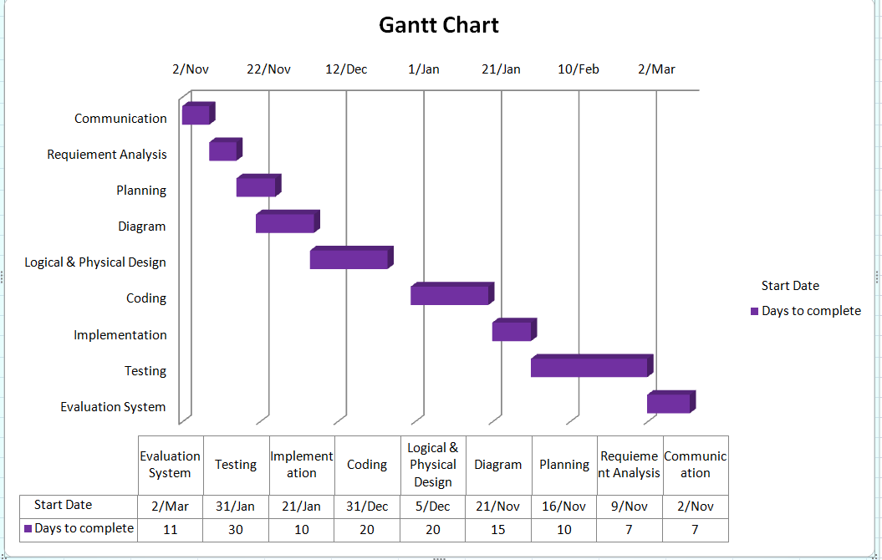

Slide 10
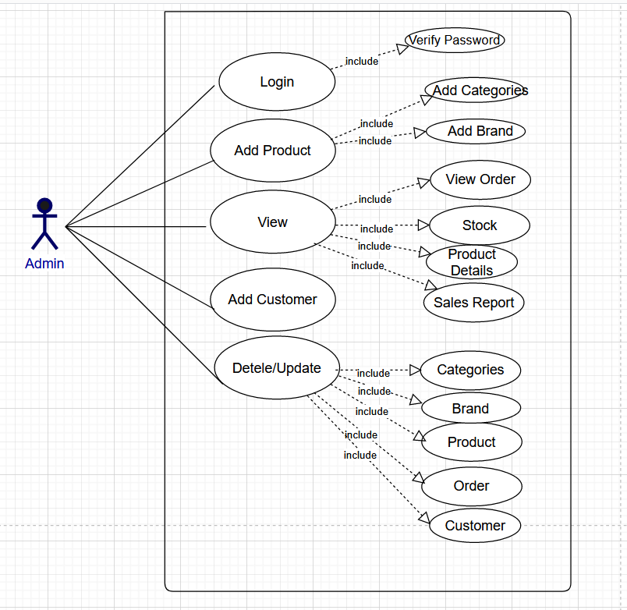
DESIGN APPROACH Use Case Diagram: Admin

Slide 11
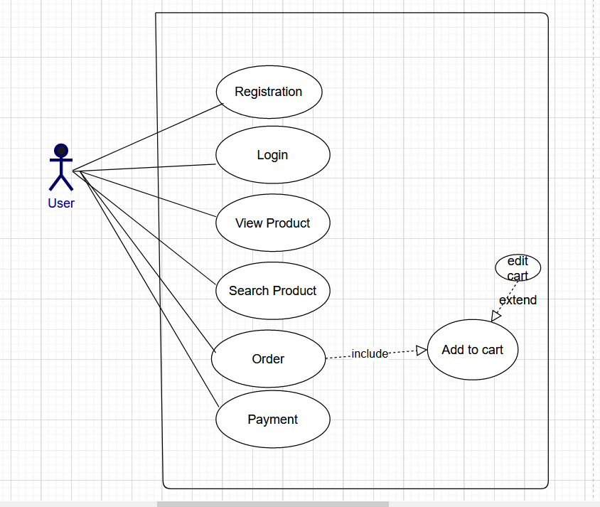
DESIGN APPROACH Use Case Diagram: User

Slide 12
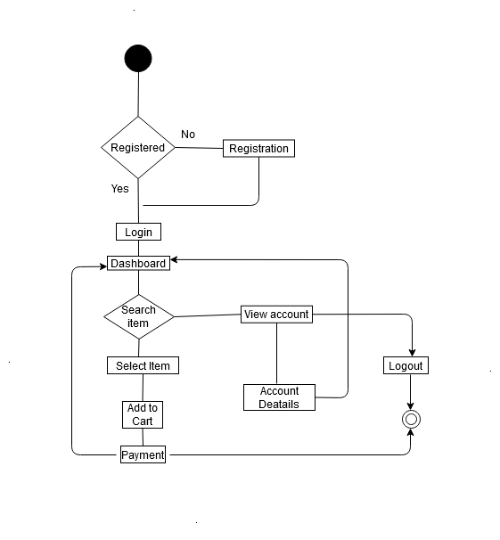
Activity Diagram

Slide 13
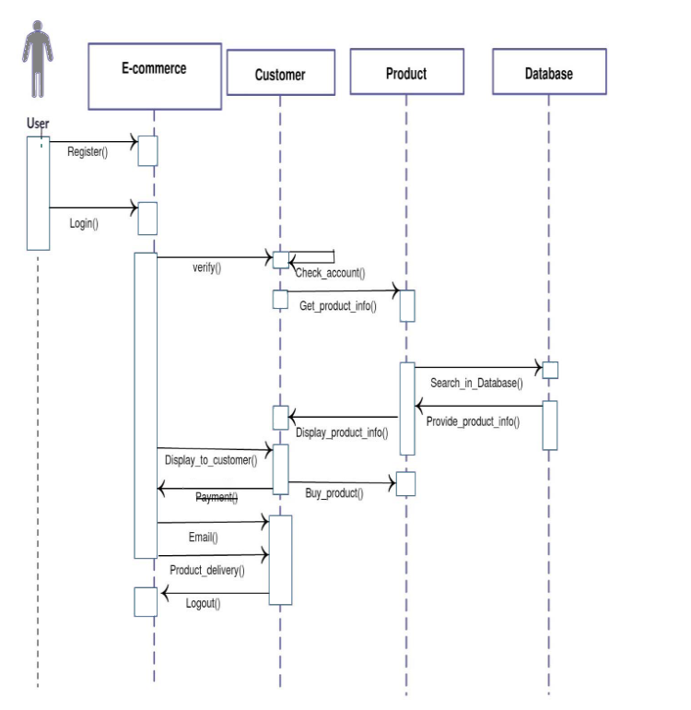
Sequence Diagram

Slide 14
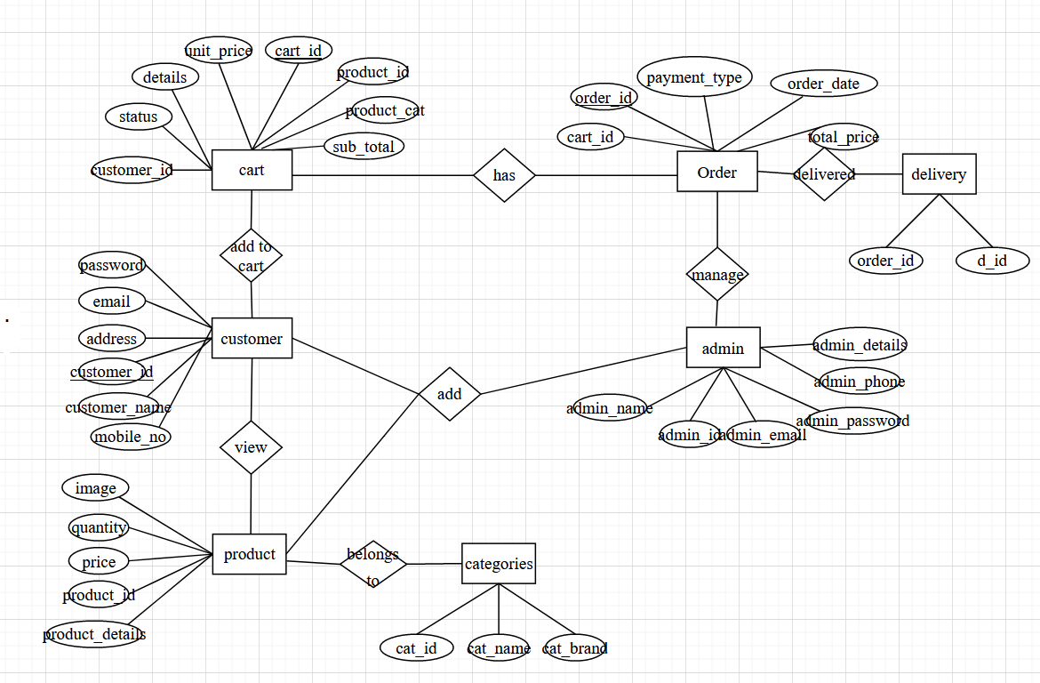
ER Diagram

Slide 15
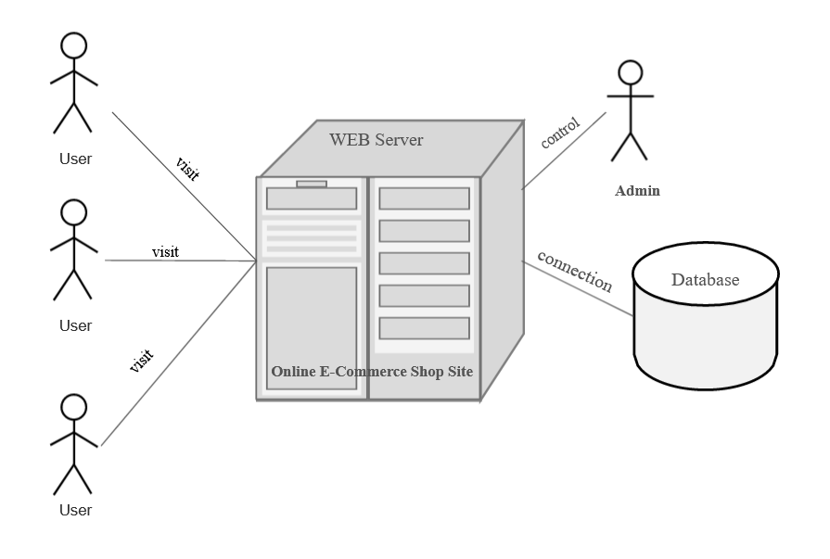
DEPLOYMENT Diagram

Slide 16
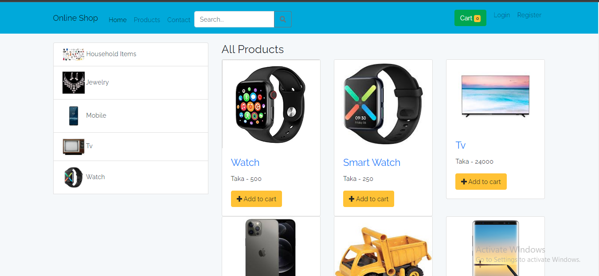
Website interface Homepage

Slide 17
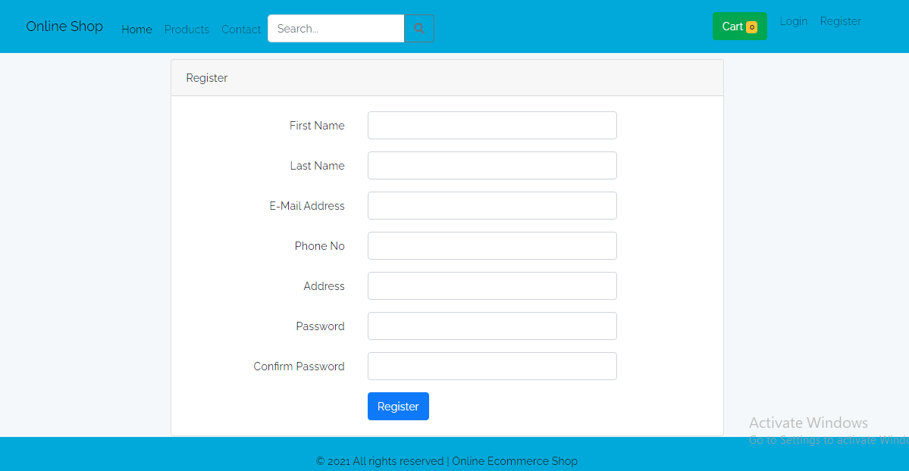
Website interface User registration

Slide 18
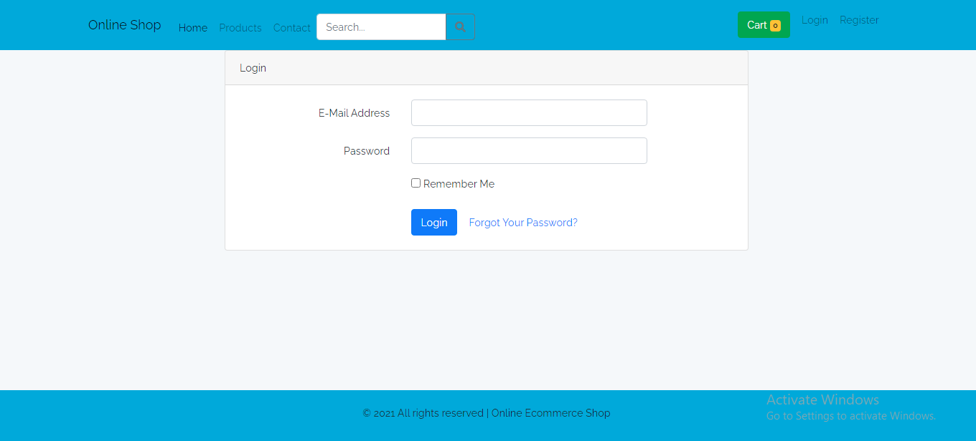
Website interface User login

Slide 19
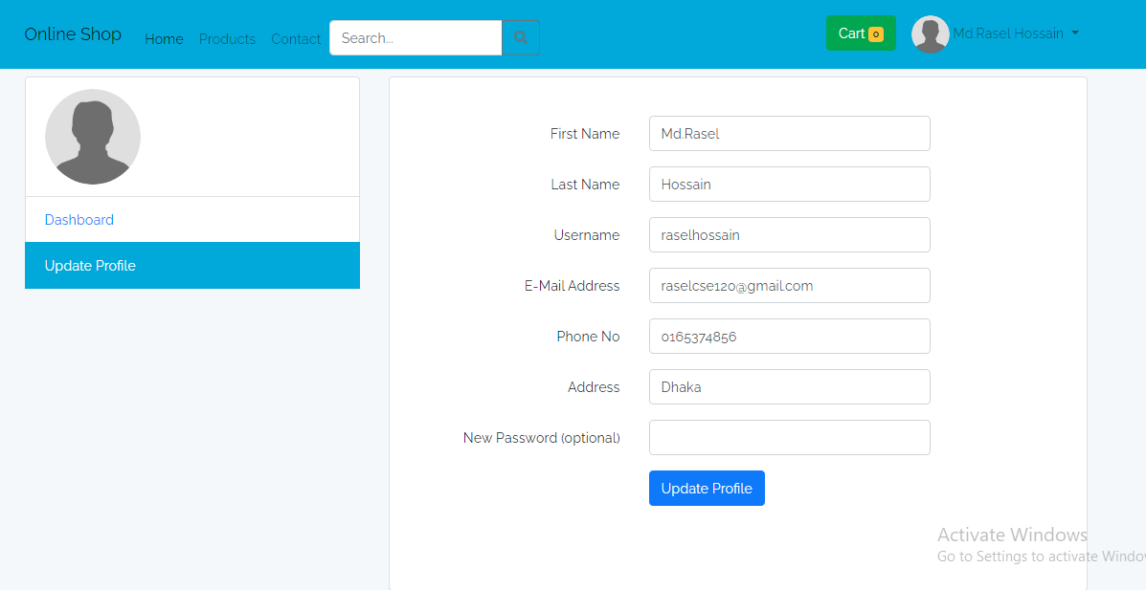
Website interface User profile

Slide 20
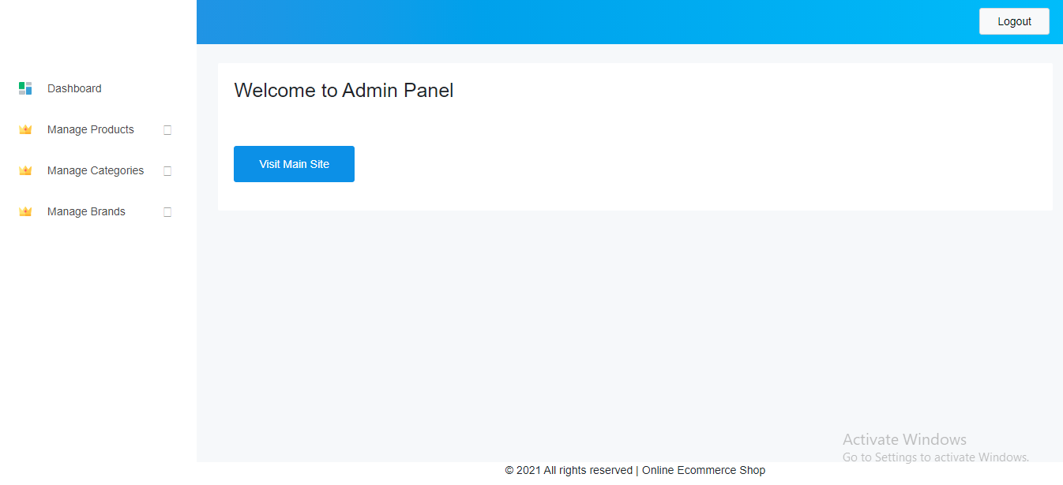
Website interface admin dashboard

Slide 21
LIMITATION
Without registration user can not buy product.
The ordered place distance will make long time to delivery.
After complete payment user can not displace the order.
Online transaction or Credit card validation is not done

Slide 22
FUTURE WORK
Some of the features that will be modified and added to this system.
Third party software can be used for validation check.
we will try to apply artificial intelligence (AI) based features to our project.
We will make our security stronger to find out real users.
Integrate Payment system.

Slide 23
CONCLUSION
This project will be full development and evaluation process of the e-commerce portal. That allows products buy a single one stop marketplace or home to purchase their products. The design for the customer, administration feature and the vendor portal. All the features will be developed in PHP.

Slide 24


